Slide 1
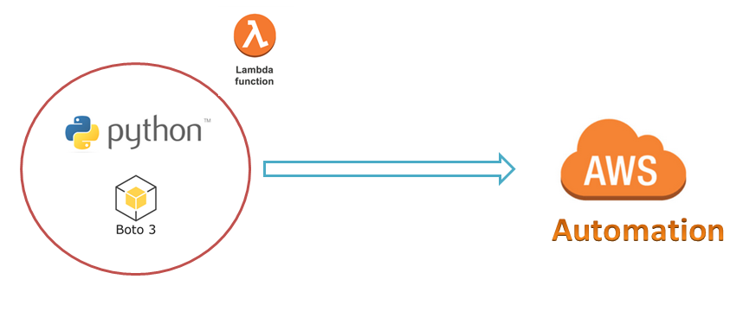
AWS Automation
with
boto3 of Python and Lambda Functions
How to install Python-3.x and boto3 on Windows Server ?
Loop control statements or commands
(break and continue)
Learn how to automate AWS common tasks using boto3 and Lambda

Slide 2

Installing Python-3.x and boto3 on Windows Server
Python-3.7.4
Go to www.python.org
Set Paths for python and pip3
Install boto3
pip3 install boto3
Loop control statements or commands
(break and continue)
Learn how to automate AWS common tasks using boto3 and Lambda

Slide 3
Thank you

